Slide 1
Procurement Training – Managers
11 January 2023

Slide 2
Introductions
Can you please confirm:
Your Name
Your Position
Your experience of procurement
What you would like to get out of today’s training,

Slide 3
John Moody
Chartered Accountant - specialist in Governance, Risk and Compliance
Contract Auditor – specialising in large revenue and capital projects
Risk Management Consultant for to multi-million euro critical infrastructure projects for governments and across most industry sectors
Designed performance related contracts and control mechanisms for contracts in range €1M to multi billion euro deals

Slide 4
Rules
This is a learning environment
Open discussions
No such thing as a bad question
Avoid interruptions unless essential –lap tops off.

Slide 5
Learning Objectives
To provide targeted training following the launch of the LSI’s Procurement Policy in November 2022 covering all expenditure over €10,000 per annum (inclusive of VAT):
Stakeholder expectations
Preparation of a BRD
Identifying the level of approval required
Planning and running a tendering exercise
Evaluating tenders using MEAT
Contract Management
Managing the risk of potential overspends
Learning from procurement failures

Slide 6
Stakeholder Expectations
Group session
Who are the Law Society of Ireland’s key stakeholders?
What do you think our key stakeholders expect from us when we procure goods and services?

Slide 7
Key Stakeholders
Members
Students
LSI Staff
Key Suppliers and Partners
The Public.

Slide 8
Stakeholder Expectations – possible answers
We demonstrate stewardship by?
Demonstrating that we obtain value for money
Complying with any existing procurement deals with preferred suppliers (see contracts register)
Transparency, quality and accountability
Minimising waste and extravagance
Take reasonable steps to reduce fraud
Avoiding unethical use of materials or labour in our supply chain and select environmentally friendly options, where possible
Not using suppliers who provide poor quality goods or services.
Our procurement policy provides a set of rules to ensure we meet our stakeholder expectations.

Slide 9
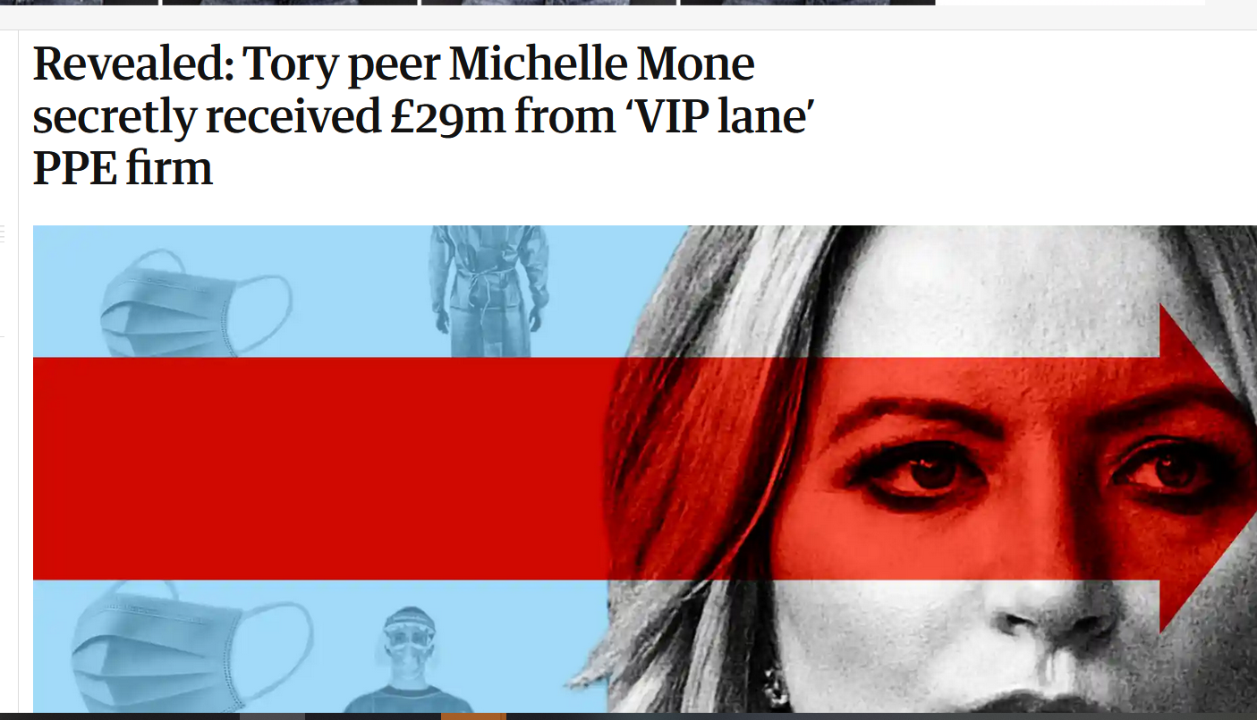
What could possibly go wrong?
https://www.theguardian.com/uk-news/2022/nov/23/revealed-tory-peer-michelle-mone-secretly-received-29m-from-vip-lane-ppe-firm

Slide 10
Risk and Larger Value Contracts
Group session
Does risk increase with larger value contracts?
Why?

Slide 11
Risks
Risk Drivers
Contract values are much higher
Volumes increase – can be time consuming to manage and measure
Contracts can last for more than one year
Contracts give rights to the supplier /contractor
There may be reputational risks – LSI perceived to be guilty by association
GDPR considerations
Dealing with companies that are much larger than the LSI and insist on using their contract terms and face dedicated procurement and contract management staff
Potential disputes over Terms and Conditions or what is in-scope and out of scope
Unethical employment conditions or supply chain
Legal disputes can be expensive to resolve and are rarely satisfactory
Environmental considerations.

Slide 12
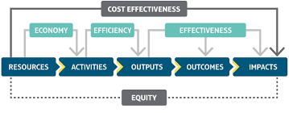
Value for Money
Value for money requires planning and preparation.

Slide 13
Mitigations
Engineer risk out of the process
The LSI needs to use a standard set of contract conditions – that covers:
  Data protection
  Variations
  Performance and liquidated damages
  Ethical and Environmental considerations
  Turnover rules
  PI and general Insurance requirements
  Conflict resolution and mediation

Slide 14
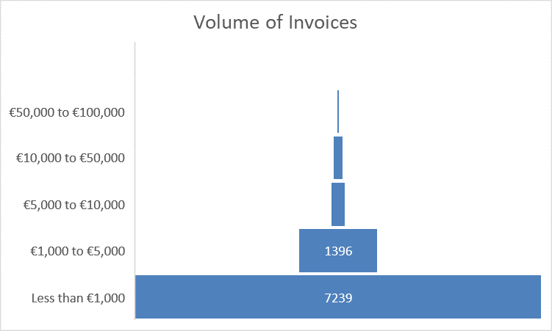
LSI Invoice Analysis
44% of total spend

Slide 15
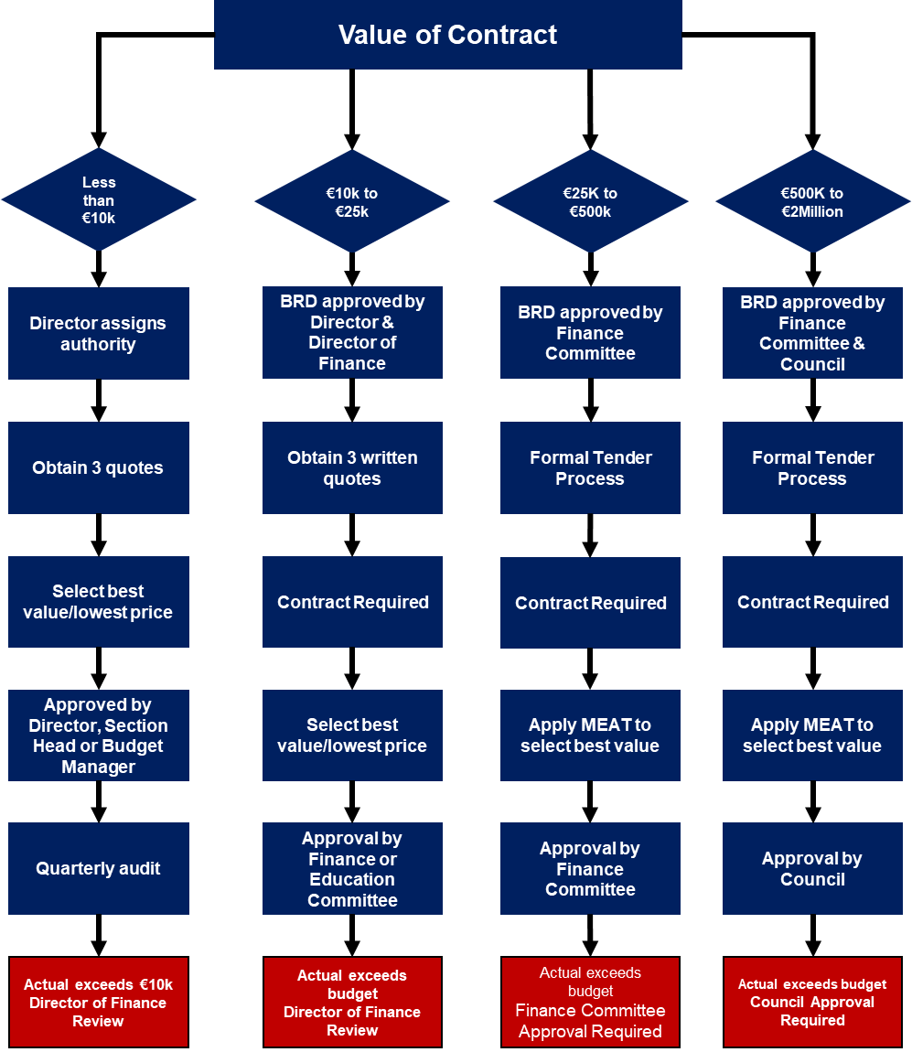
Procurement Routes
Area of Focus

Slide 16
Other key aspects
When less than three quotes is permissible:
Only if business justification can be provided – only one supplier can respond within a critical time frame
If there are limited market options i.e. a specialist service with limited suppliers
If the LSI already has a preferred supplier for the supply of goods and services
If the expenditure is recurring – repeat competition on an annual basis or more regularly if there are major price increases.

Slide 17
Budgetary Approval Heirarchy
Council
Finance Committee
Director of Finance
Director
Budget Holder
Director
Director
Director
Budget Holder
Budget Holder
Budget Holder

Slide 18
Group Session
Based on your own experience, what practical steps can we take to ensure the LSI receives value for money?

Slide 19
Group Session
Possible answers:
Understand the market and the reputable and long standing suppliers
Define your needs as precisely as you can before engaging with suppliers; how many?; when, quality criteria, what is critical (red lines), essential and desirable
Confirm whether the LSI already has a preferred supplier
Reference previous procurement exercise to identify poor performance (effectiveness)
Contact a representative sample of suppliers and invite quotes and how they can meet quality criteria around product guarantees or delivery needs (efficiency and economy)
Tell suppliers you are contacting their competitors and ask for their best price (economy).

Slide 20
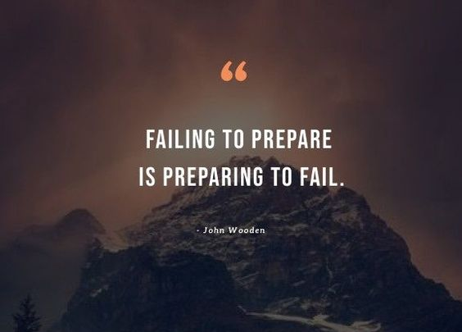
Preparation

Slide 21
Start with the end in sight
Pre-Contract & Specification
Tender & Contract Award
Contract Delivery & Payment

Slide 22
BRD Walk Through

Slide 23
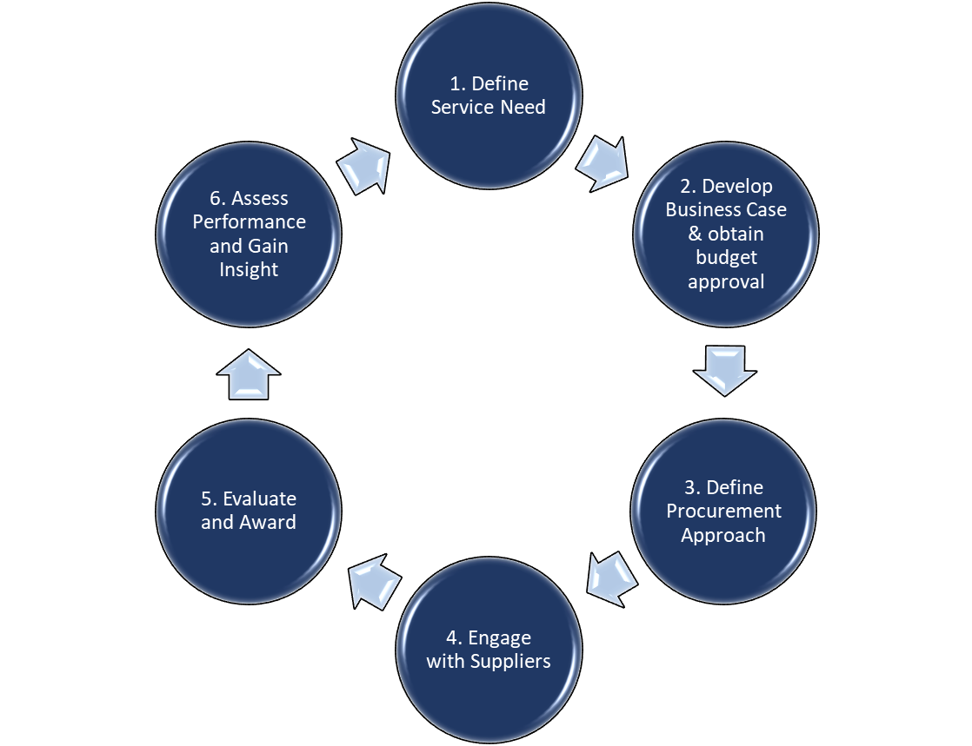
LSI’s Procurement Process

Slide 24
What Contractors really want….
Contract Management
Super Profit
Specifications
Materials/Labour and Profit

Slide 25
Is cheapest always best?
Quality considerations?
End of range products?
Sale?
ESG?
After sale service or product guarantee?
If its too good to be true…….

Slide 26
MEAT – for all contracts over €25,000
Contracts valued over €25,000 (inclusive of VAT) should be awarded on the basis of Most Economically Advantageous Tender (‘MEAT’).
Marks should be awarded for price and quality based on an assessment of the overall complexity and degree of specialism required. For example:
Highly technical tenders should be weighted 80% quality and 20% price (i.e. advisory services)
Combining a tenderer’s quality score with the price to calculate a Price Quality Ratio i.e. how much the LSI will pay for quality.
The MEAT process should be recorded and shared with all contractors.
All communication with tenderers should be open and shared until contract is awarded – unless tender process includes a negotiation stage.

Slide 27
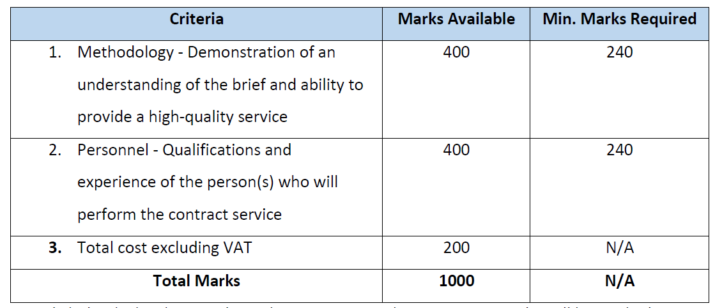
Quality Evaluation Criteria 80% Quality 20% Price

Slide 28
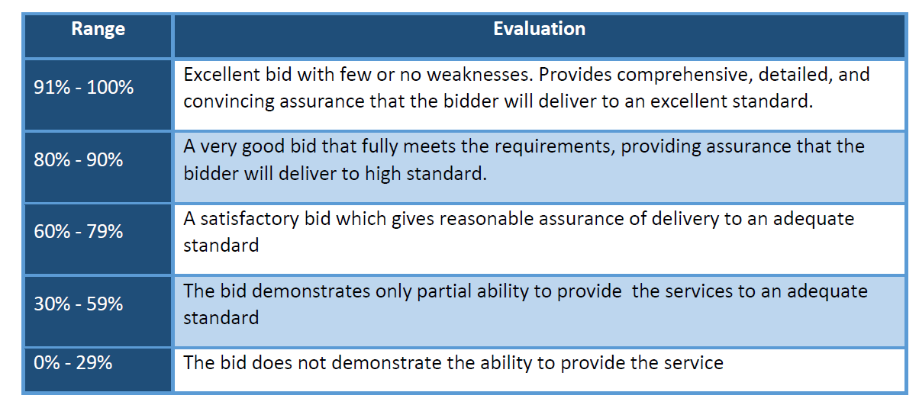
Quality Evaluation

Slide 29
MEAT – Calculation
Options
Lowest price bid X price weighting = Price Score
Price of tender being evaluated
Total Points = Price Score + Quality Score (award contract to tenderer with the highest points)
Concern (where Price > 50%)– bids are not treated discretely – decision can be skewed based on lowest priced tender, which may be too low to be credible
Or
Quality Score (out of 100) = Price Quality Score – also referred to as VFM rating
Price Tendered
Select the Tender that achieved the highest ratio.

Slide 30
Tender Evaluation Example – Included in Toolkit
Worked Example
Price Weighting | 20
Quality Weighting | 80
Tenderer | Price | Price Score | Quality Score (award out of 100) | Weighted Quality Score | MEAT Score | Price Quality Score or VFM Index
Tender A | €60,000 | 20.0 | 50 | 40 | 60.0 | 0.83333
Tender B | €70,000 | 17.1 | 85 | 68 | 85.1 | 1.21429
Tender C | €80,000 | 15.0 | 75 | 60 | 75.0 | 0.93750
Tender D | €90,000 | 13.3 | 95 | 76 | 89.3 | 1.05556
Lowest Tender Price | €60,000 |  |  |  | The highest score represents the most competitive tender. Use either MEAT or Price Quality Score
Key
Input Cells
Calculations
Output - Report

Slide 31
Value for Money
Value for money requires planning and preparation.

Slide 32
Budget Provision for orders Greater than €25,000
Walk through an example of a BRD, which needs to be submitted two weeks before a Finance Committee meeting. (FC Colander is included on the LSI’s procurement intranet site).
- Office 365

Slide 33
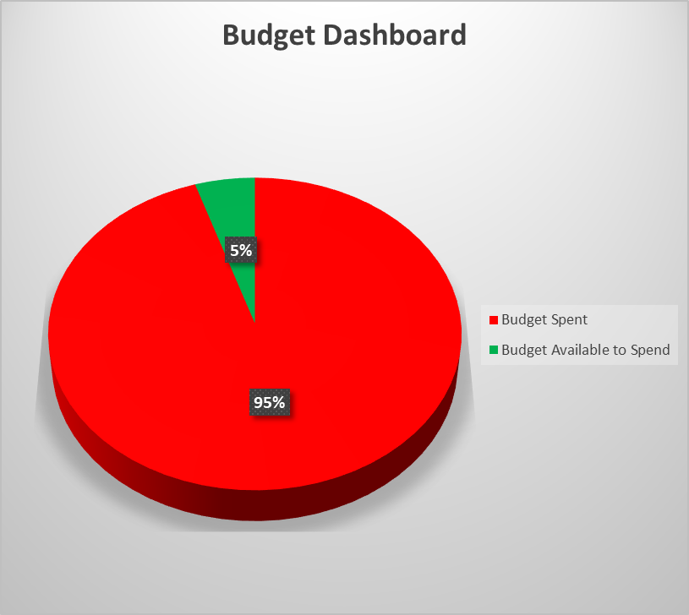
Budget Dashboard – Included in Toolkit

Slide 34
Managing Potential Budget Overspends
Where an approved expenditure budget is likely to be, or has been, exceeded by a material amount, the budget manager must notify the Director of Finance & Operations immediately, who will review and advise on potential actions to limit the overspend and whether it is necessary to seek supplementary approval from the Finance or Education Committees. This notification should include:
  Original approved BRD
  A brief summary that states how the overspend occurred, what this is likely to be and explains why additional expenditure is necessary
  Whether other budgets can be used to fund the overspend
  Confirmation that there will be no further overspends

Slide 35
Managing Potential Overspends
Where an approved expenditure budget is likely to be, or has been, exceeded by a material amount, the budget manager must notify the Director of Finance & Operations immediately, who will review and advise on potential actions to limit the overspend and whether it is necessary to seek supplementary approval from the Finance or Education Committees.
This notification should include:
Original approved BRD
A brief summary that states how the overspend occurred, what this is likely to be and explains why additional expenditure is necessary
Whether other budgets can be used to fund the overspend
Confirmation that there will be no further overspends

Slide 36
Contract Management - Tips
Ensure there are clear and measurable outputs for success and failure – ones that you can easily verify
Build a relationship through active engagement with the contractor
Confirm the cost of variations or other contract adjustments before approving them and always record them
Record all contract communications in a central file
Monitor on an on-going basis – a continuous/agile review process
Encourage a “no-surprises approach” – if there is a problem, what is it and how can it be resolved
If highly specialist – use a specialist Project Lead to manage the contract
Have a clearly defined end point for the contract – production of a report or delivery of good or services
Consider a retention pending final acceptance of service/goods
Diarise the contract expiry/renewal date and initiate a new competition on time (to avoid unwanted extensions).
Complete a Post Contract review to assess client and contractor performance and inform the next competition – what improvements could be made?

Slide 37
Group Exercises
Case Studies for expenditure below €10,000 (inclusive of VAT):
Invite actual competitions from the group – capture critical variables and resolve in an interactive group session.
Can we also discuss where a supplier has failed to deliver goods or services.
Note: key learning points will be captured and shared with all attendees.

Slide 38
Tips and Pitfalls
Pitfalls
Tips/Best Practice
Being unprepared – doing everything in the last minute
Using optimism bias or focusing too much on cost
Awarding a high value contract to a very small firm
Adopting input based specifications, which are difficult to measure
Rely on a fixed price contract in periods of price volatility
Having a clear understanding of your needs, the market and what good looks like – who, what, where and when
Google all prospective firms
Meet the delivery team rather than
Accept a supplier needs to make a profit
Award contracts to suppliers who have the appropriate scale and experience
Using output and performance based specifications
Include a provision for inflation within cost estimate.

Slide 39
Handouts and Reference Material
We will share the following documents at the end of the training sessions:
A copy of these slides
Access to a tool kit to assist in budget monitoring or to complete a tender evaluation process
A set of answers to frequently asked questions
A copy of the latest LSI Procurement Policy.
Note: key learning points will be captured and shared with all attendees.

Slide 40

Questions and Answers

