Slide 1
Procurement Training - General
12 January 2023

Slide 2
Introductions
Can you please confirm:
Your Name
Your Position
Your experience of procurement
What you would like to get out of today’s training,

Slide 3
John Moody
Chartered Accountant - specialist in Governance, Risk and Compliance
Contract Auditor – specialising in large revenue and capital projects
Risk Management Consultant for to multi-million euro critical infrastructure projects for governments and across most industry sectors
Designed performance related contracts and control mechanisms for contracts in range €1M to multi billion euro deals

Slide 4
Rules
This is a learning environment
Open discussions
No such thing as a bad question
Avoid interruptions unless essential –lap tops off.

Slide 5
Learning Objectives
To provide targeted training following the launch of the LSI’s Procurement Policy in November 2022 covering the following areas for expenditure less than €10,000 per annum (inclusive of VAT):
Stakeholder expectations
Identifying approval routes
Ensuring that there is a budget provision
Seeking prior approval for the expenditure and budget overspends
Achieving value for money
Learning from procurement failures

Slide 6
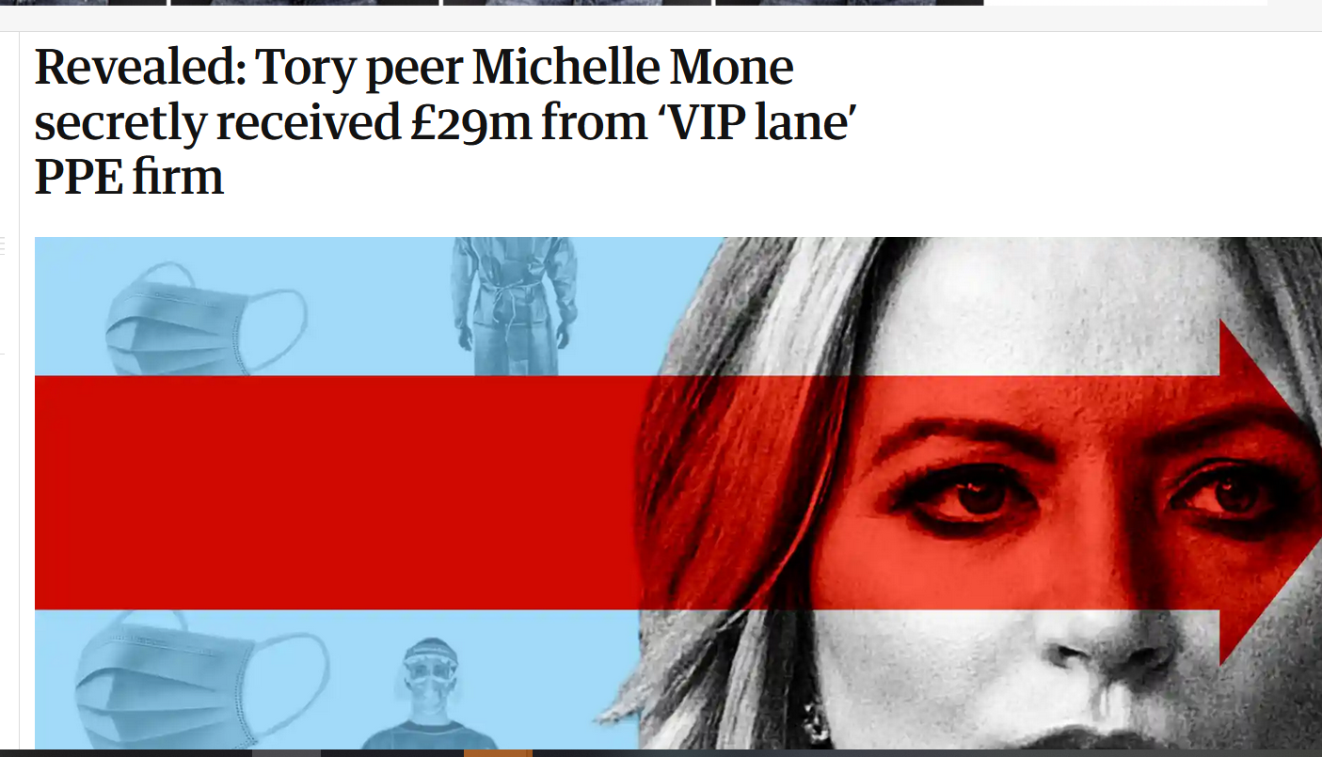
What could possibly go wrong?
https://www.theguardian.com/uk-news/2022/nov/23/revealed-tory-peer-michelle-mone-secretly-received-29m-from-vip-lane-ppe-firm

Slide 7
Stakeholder Expectations
Group session
Who are the Law Society of Ireland’s key stakeholders?
What do you think our key stakeholders expect from us when we procure goods and services?

Slide 8
Key Stakeholders
Members
Students
LSI Staff
Key Suppliers and Partners
The Public.

Slide 9
Stakeholder Expectations – possible answers
We demonstrate stewardship by?
Demonstrating that we obtain value for money
Complying with any existing procurement deals with preferred suppliers (see contracts register)
Transparency, quality and accountability
Minimising waste and extravagance
Make independent decisions when using suppliers
Take reasonable steps to reduce fraud
Avoiding unethical use of materials or labour in our supply chain and select environmentally friendly options, where possible
Not using suppliers who provide poor quality goods or services.
Our procurement policy provides a set of rules to ensure we meet our stakeholder expectations.

Slide 10
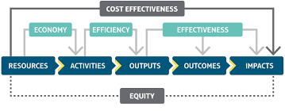
Value for Money
Value for money requires planning and preparation.

Slide 11
Is cheapest always best?
Quality considerations?
End of range products?
Sale items?
ESG considerations (long lasting or disposable)?
After sale service or product guarantee?
If a deal looks too good to be true…….

Slide 12
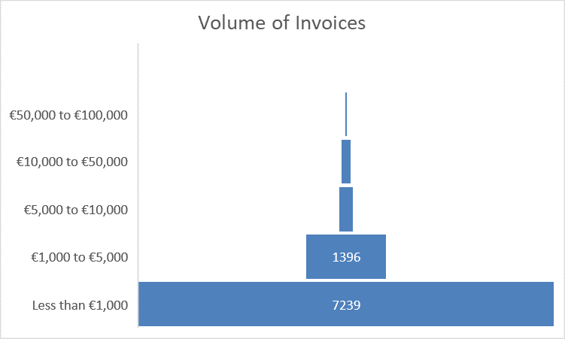
LSI Invoice Analysis

Slide 13
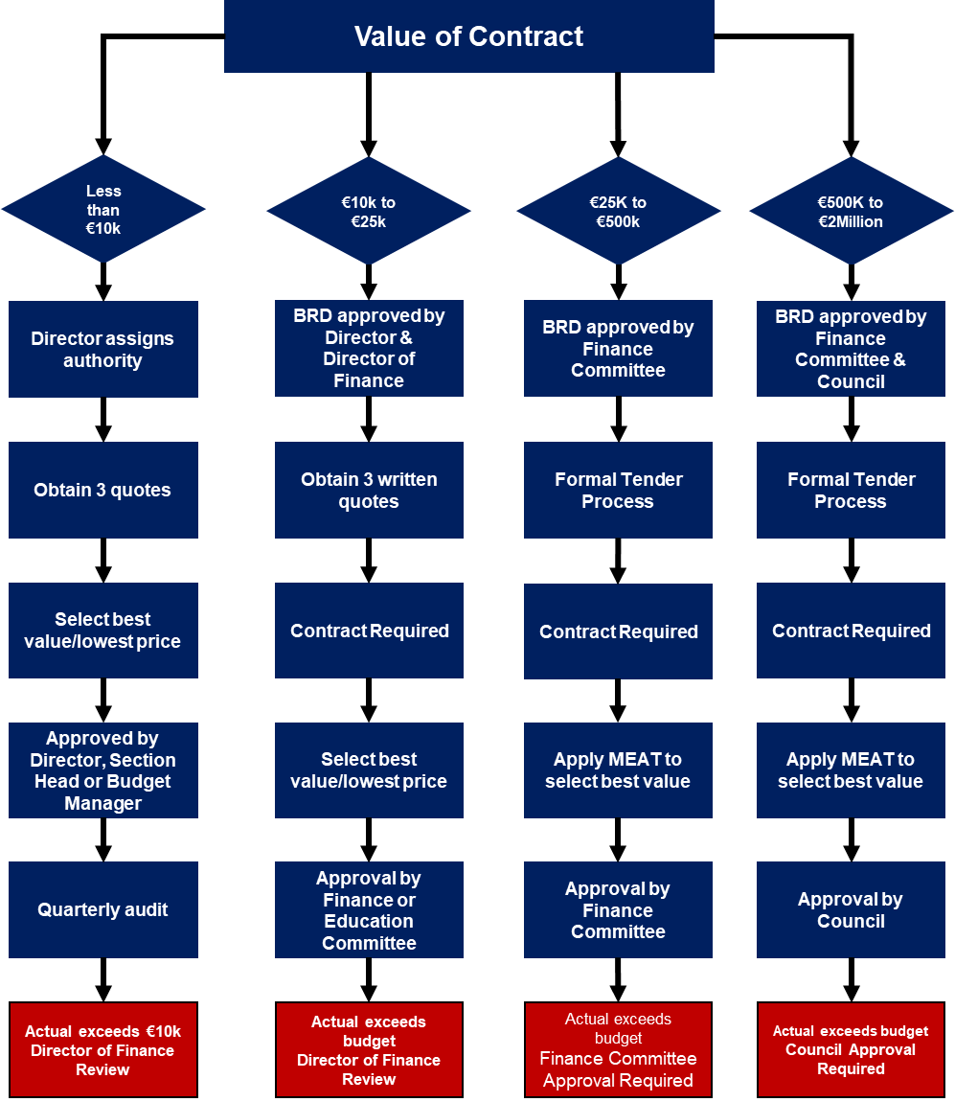
Procurement Routes
Area of Focus

Slide 14


Implementation – big bang or journey?

Slide 15
Other key aspects
When less than three quotes is permissible:
Only if business justification can be provided – only one supplier can respond within a critical time frame
If there are limited market options i.e. a specialist service with limited suppliers
If the LSI already has a preferred supplier for the supply of goods and services
If the expenditure is recurring – repeat competition on an annual basis or more regularly if there are major price increases.

Slide 16
Group Session
Based on your own experience, what practical steps can we take to ensure the LSI receives value for money?

Slide 17
Group Session
Possible answers:
Understand the market and the reputable and long standing suppliers and speak with industry peers or other bodies
Define your needs as precisely as you can before engaging with suppliers; how many?; when, quality criteria, what is critical (red lines), essential and desirable
Confirm whether the LSI already has a preferred supplier (procurement contract/agreement)
Reference previous procurement exercise to identify poor performance (effectiveness) and share assessments internally
Contact a representative sample of suppliers and invite quotes and how they can meet quality criteria around product guarantees or delivery needs (efficiency and economy)
Tell suppliers you are contacting their competitors and ask for their best price (economy).

Slide 18
Budget Provision
Key Stages
Once you have confirmed that there is a genuine business need you need to quantify the value of the purchase to obtain the correct approval.
The procurement value is calculated by considering the annual value of goods or services being procured – including VAT – so a monthly order for a particular good or service of €1,000 – should be treated as expenditure of €12,000 – where a formal tender process is required
If there is already a provision in the annual service budget – the Budget manager can approve the order.
If there is no budget provision, the order must be approved by the Director.

Slide 19
Approval to place orders that are less than €10,000
Obtain 3 Quotes (ideally written over €1,000)
Included in annual Budget
Budget Manager Approval
Not Included in Budget
Director Approval Required
Orders less than €10,000

Slide 20
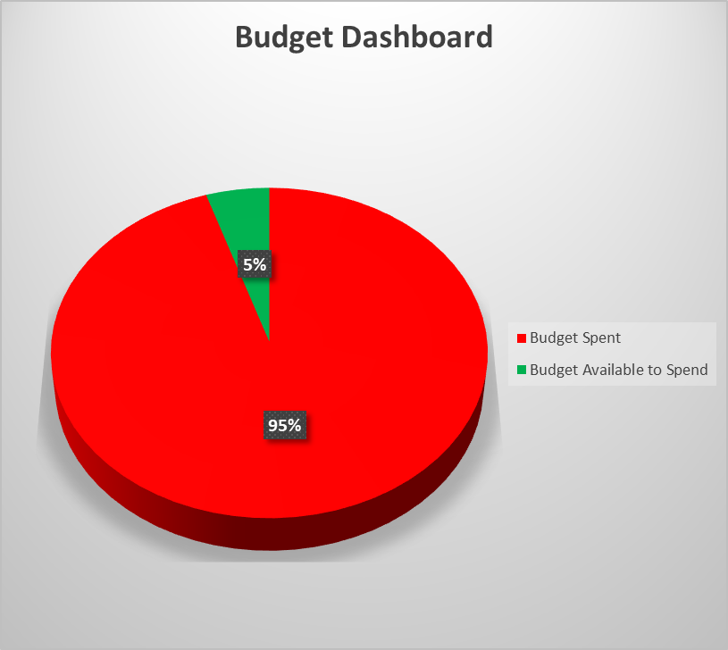
Budget Dashboard – Included in Toolkit

Slide 21
Group Exercises
Case Studies for expenditure below €10,000 (inclusive of VAT):
Group to suggest recent examples of actual competitions – capture critical variables and resolve in an interactive group session.
Can we also discuss where a supplier has failed to deliver goods or services.
Note: key learning points will be captured and shared with all attendees.

Slide 22
Tips and Pitfalls
Pitfalls
Tips/Best Practice
Being unprepared – doing everything in the last minute
Focusing too much on cost
Making assumptions and not sharing them with the supplier/contractor
Awarding a high value contract to a very small firm
Adopting input based specifications, which are difficult to measure
Rely on a fixed price contract in periods of price volatility
Having a clear understanding of your needs, the market and what good looks like – who, what, where and when
Speak with peer firms and ask about suppliers and cost
Google all prospective firms
Meet the delivery team rather than the sales person
Accept that a supplier needs to make a profit
Award contracts to suppliers who have the appropriate scale and experience
Using output and performance based specifications
Include a provision for inflation within cost estimates.

Slide 23
Some Tips
https://www.youtube.com/watch?v=7GNqoatKMdo

Slide 24
Handouts and Reference Material
We will share the following documents at the end of the training sessions:
A copy of these slides
Access to a tool kit to assist in budget monitoring or to complete a tender evaluation process
A set of answers to frequently asked questions
A copy of the latest LSI Procurement Policy.
Note: key learning points will be captured and shared with all attendees.

Slide 25

Questions and Answers

